Slide 1
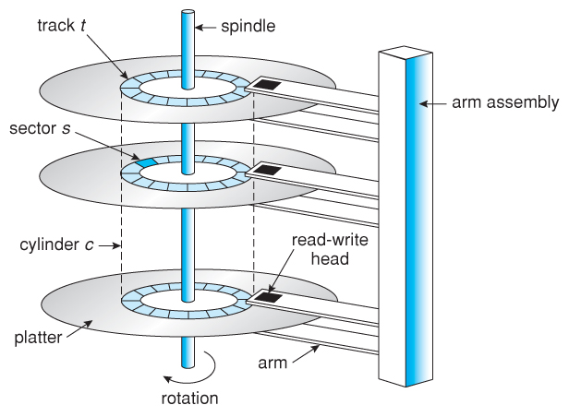
The Pseudo-columns
A pseudo-column behaves like a table column, but is not actually stored in the table.
You can select from pseudo-columns, but you cannot insert, update, or delete their values.
Oracle has many pseudo-columns like rowid, rownum, nextval, currval, …
ROWID
It is the physical address of a record i.e. a hexadecimal number storing the exact location on the hard disk
It contains the sector number, track number, record number, etc. on the disk
It is unique for every record
Does not change ever

Slide 2
ROWID and ROWNUM
ROWNUM
It is the access number of a record (associated with every select query)
The sequence number in which a record is fetched from the database
Every record has a unique rownum for every query
Every query generates rownums depending on the query and the records which are being fetched
It always starts from 1 and the maximum value is the number of records fetched in that query
select rowid, rownum, empno, ename
from emp
where deptno = 20;
(By default Oracle always displays the records in the sequence in which they in were inserted)
ROWID | ROWNUM | EMPNO | ENAME | SAL
AGfedvAAkAAAAJeAAD | 1 | 7566 | JONES | 2975
AGfedvAAkAAAAJeAAE | 2 | 7788 | SCOTT | 3000
AGfedvAAkAAAAJeAAF | 3 | 7902 | FORD | 3000
AGfedvAAkAAAAJeAAG | 4 | 7369 | SMITH | 800
AGfedvAAkAAAAJeAAL | 5 | 7876 | ADAMS | 1100

Slide 3

ROWID and ROWNUM
select rowid, rownum, empno, ename, sal from emp
where deptno = 20 order by sal;
ROWID | ROWNUM | EMPNO | ENAME | SAL
AGfedvAAkAAAAJeAAG | 4 | 7369 | SMITH | 800
AGfedvAAkAAAAJeAAL | 5 | 7876 | ADAMS | 1100
AGfedvAAkAAAAJeAAD | 1 | 7566 | JONES | 2975
AGfedvAAkAAAAJeAAE | 2 | 7788 | SCOTT | 3000
AGfedvAAkAAAAJeAAF | 3 | 7902 | FORD | 3000
select rowid, rownum, empno, ename, sal from emp
where sal > 2500;
ROWID | ROWNUM | EMPNO | ENAME | SAL
AGfedvAAkAAAAJeAAA | 1 | 7839 | KING | 5000
AGfedvAAkAAAAJeAAB | 2 | 7698 | BLAKE | 2850
AGfedvAAkAAAAJeAAD | 3 | 7566 | JONES | 2975
AGfedvAAkAAAAJeAAE | 4 | 7788 | SCOTT | 3000
AGfedvAAkAAAAJeAAF | 5 | 7902 | FORD | 3000

Slide 4

ROWID and ROWNUM
IMP
ROWID will never change for any record
ROWNUM may change depending on the query

Slide 5
Suppose we have a table emptemp which does not have a primary key.
The structure is similar to that of the emp table. By mistake many duplicate records have got added to this table.
Write a DELETE command that will delete the duplicates
The emptemp table contains the following data:
EMPNO | ENAME | JOB | MGR | HIREDATE | SAL | COMM | DEPTNO
7839 | KING | PRESIDENT | - | 17-NOV-81 | 5000 | - | 10
7698 | BLAKE | MANAGER | 7839 | 01-MAY-81 | 2850 | - | 30
7782 | CLARK | MANAGER | 7839 | 09-JUN-81 | 2450 | - | 10
7566 | JONES | MANAGER | 7839 | 02-APR-81 | 2975 | - | 20
7566 | JONES | MANAGER | 7839 | 02-APR-81 | 2975 | - | 20
7839 | KING | PRESIDENT | - | 17-NOV-81 | 5000 | - | 10
7782 | CLARK | MANAGER | 7839 | 09-JUN-81 | 2450 | - | 10
7566 | JONES | MANAGER | 7839 | 02-APR-81 | 2975 | - | 20
7782 | CLARK | MANAGER | 7839 | 09-JUN-81 | 2450 | - | 10
7566 | JONES | MANAGER | 7839 | 02-APR-81 | 2975 | - | 20
7782 | CLARK | MANAGER | 7839 | 09-JUN-81 | 2450 | - | 10
7566 | JONES | MANAGER | 7839 | 02-APR-81 | 2975 | - | 20
7566 | JONES | MANAGER | 7839 | 02-APR-81 | 2975 | - | 20

Slide 6
select rowid, empno, ename from emptemp;
ROWID | EMPNO | ENAME
AGffBjADCAAAANLAAA | 7839 | KING
AGffBjADCAAAANLAAB | 7698 | BLAKE
AGffBjADCAAAANLAAC | 7782 | CLARK
AGffBjADCAAAANLAAD | 7566 | JONES
AGffBjADCAAAANMAAA | 7566 | JONES
AGffBjADCAAAANNAAA | 7839 | KING
AGffBjADCAAAANNAAC | 7782 | CLARK
AGffBjADCAAAANNAAD | 7566 | JONES
AGffBjADCAAAANNAAE | 7782 | CLARK
AGffBjADCAAAANNAAF | 7566 | JONES
AGffBjADCAAAANNAAG | 7782 | CLARK
AGffBjADCAAAANNAAH | 7566 | JONES
AGffBjADCAAAANNAAI | 7566 | JONES
KING – 2 rows
BLAKE – 1 row
CLARK – 4 rows
JONES – 6 rows

Slide 7

delete from emptemp
where rowid not in
(select max(rowid)
from emptemp
group by empno)
Inner query:
7839(KING) – 2 rows
7698(BLAKE) – 1 row
7782(CLARK) – 4 rows
7566(JONES) – 6 rows
After execution of query if you select from the emptemp table:
MAX(ROWID)
AGffb8AB7AAAAPTAAL
AGffb8AB7AAAAPTAAG
AGffb8AB7AAAAPTAAN
AGffb8AB7AAAAPTAAF
EMPNO | ENAME | JOB | MGR | HIREDATE | SAL | COMM | DEPTNO
7839 | KING | PRESIDENT | - | 17-NOV-81 | 5000 | - | 10
7698 | BLAKE | MANAGER | 7839 | 01-MAY-81 | 2850 | - | 30
7782 | CLARK | MANAGER | 7839 | 09-JUN-81 | 2450 | - | 10
7566 | JONES | MANAGER | 7839 | 02-APR-81 | 2975 | - | 20

Slide 8

CREATE command revisited…
create table emptemp as
select * from emp;
desc emptemp
The structure and data are copied but the constraints are not copied.
What if we want to copy the structure but not the data??
create table emptemp as
select * from emp
where 1 = 2;
Column | Null? | Type
EMPNO | - | NUMBER(4,0)
ENAME | - | VARCHAR2(10)
JOB | - | VARCHAR2(15)
MGR | - | NUMBER(4,0)
HIREDATE | - | DATE
SAL | - | NUMBER(7,2)
COMM | - | NUMBER(7,2)
DEPTNO | - | NUMBER(2,0)

Slide 9
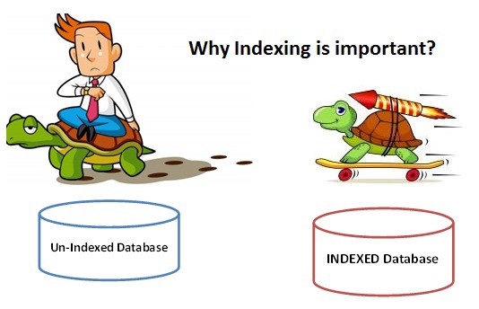
Indexing
Indexes are used to quickly locate data without having to search every row in a database table every time a database table is accessed
For fast query processing and access it is important to create index on certain columns of a table
A SQL index is a quick lookup table for finding records users need to search frequently.
Indexing a table or view is, without a doubt, one of the best ways to improve the performance of queries and applications.

Slide 10
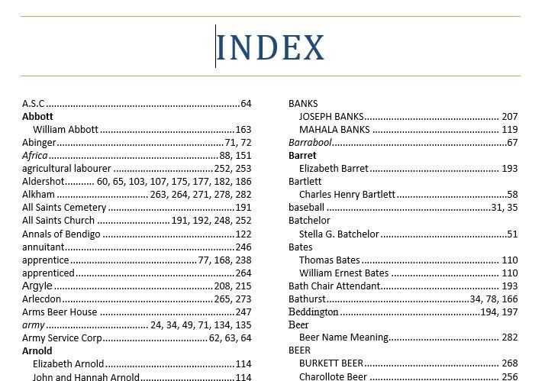
SEARCH KEY
LOCATION(ROWID)

Slide 11
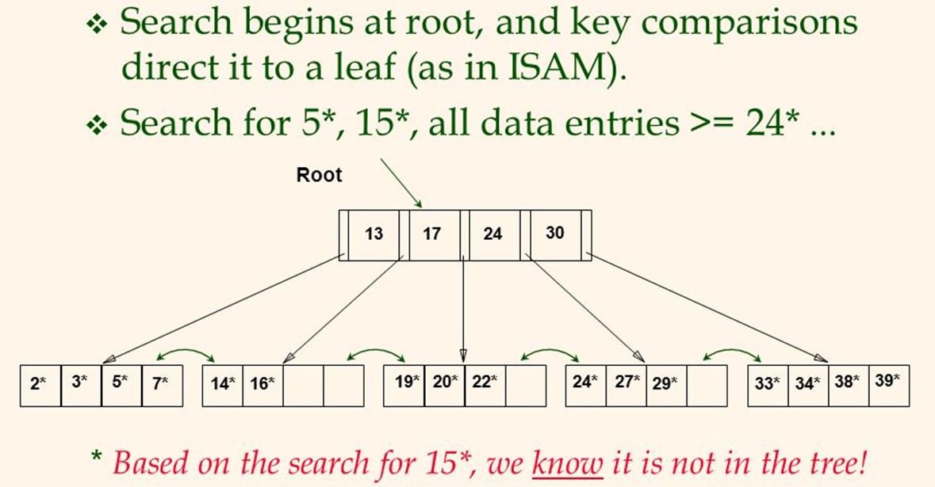

Indexing
By default Oracle creates indexes on the primary key and every candidate key
An index is stored separately from the table data
It contains only two values, the search key i.e. say the empno and the location i.e. rowid
Which data structure is used while creating an index??
B or B+ Trees / Hashing

Slide 12




Indexing
A user can create indexes depending on which queries would be fired most in the application, and on which columns.
Normally table joins are frequently required when we have a master and child/transaction table e.g. EMP and DEPT table need to be joined for information from both the tables
By default Oracle will create index on the primary keys of these tables i.e. empno of EMP table and deptno of DEPT table
For joins we require the deptno (FK) of EMP table on which there is no default index
A user should create an index on the FKs so that joins will execute fast
An index can be:
A unique index
A non-unique index
Simple index
Composite index

Slide 13
Indexing
Suppose there is no index created on deptno of EMP table.
By default deptno of DEPT table will have a unique index
EMP (without index)
DEPT Index
DEPTNO | ROWID
10 | AGgBGFAB7AAAAg3AAA
30 | AGgBGFAB7AAAAg3AAB
10 | AGgBGFAB7AAAAg3AAC
20 | AGgBGFAB7AAAAg3AAD
20 | AGgBGFAB7AAAAg3AAE
20 | AGgBGFAB7AAAAg3AAF
20 | AGgBGFAB7AAAAg3AAG
30 | AGgBGFAB7AAAAg3AAH
30 | AGgBGFAB7AAAAg3AAI
30 | AGgBGFAB7AAAAg3AAJ
30 | AGgBGFAB7AAAAg3AAK
20 | AGgBGFAB7AAAAg3AAL
30 | AGgBGFAB7AAAAg3AAM
10 | AGgBGFAB7AAAAg3AAN
DEPTNO | ROWID
10 | AGgBGDAB7AAAAgnAAA
20 | AGgBGDAB7AAAAgnAAB
30 | AGgBGDAB7AAAAgnAAC
40 | AGgBGDAB7AAAAgnAA

Slide 14
Indexing
If deptno of EMP table is indexed then the joins can be fast:
DEPT Index
EMP Index
DEPTNO | ROWID
10 | AGgBGDAB7AAAAgnAAA
20 | AGgBGDAB7AAAAgnAAB
30 | AGgBGDAB7AAAAgnAAC
40 | AGgBGDAB7AAAAgnAA
DEPTNO | ROWID
10 | AGgBGFAB7AAAAg3AAC
10 | AGgBGFAB7AAAAg3AAN
10 | AGgBGFAB7AAAAg3AAA
20 | AGgBGFAB7AAAAg3AAF
20 | AGgBGFAB7AAAAg3AAE
20 | AGgBGFAB7AAAAg3AAD
20 | AGgBGFAB7AAAAg3AAG
20 | AGgBGFAB7AAAAg3AAL
30 | AGgBGFAB7AAAAg3AAI
30 | AGgBGFAB7AAAAg3AAJ
30 | AGgBGFAB7AAAAg3AAK
30 | AGgBGFAB7AAAAg3AAM
30 | AGgBGFAB7AAAAg3AAH
30 | AGgBGFAB7AAAAg3AAB

Slide 15
Indexing
Creating user defined indexes:
Unique index
create unique index idname on dept(dname);
Unique index is similar to unique constraint
Will not allow duplicate values to be inserted in the table
Will allow null values
Non-Unique index
create index isal on emp(sal);
create index ideptno emp(deptno); (On FK)
Creates an index which allows duplicates
Called the secondary index
Simple index
Index created on a single column (all the above eamples)
Composite index
Index created on more than one column
create index idnosal on emp(deptno, sal);

Slide 16


Indexing
idnosal
Composite index
create index idnosal on emp(deptno, sal);
To remove an user defined index,
drop index indexname;
e.g.
drop index isal;
IMP:
Oracle SQL engine decides which index to use for fast execution
Every insert in a table results in an insert in the index table too
Actually every DML on a table will affect the index table if indexing column is changing
Queries become fast but DMLs become slow!!
DEPTNO | SAL | ROWID
10 | 1300 | AGgB1AAAPAAAAseAAN
10 | 2450 | AGgB1AAAPAAAAseAAC
10 | 5000 | AGgB1AAAPAAAAseAAA
20 | 800 | AGgB1AAAPAAAAseAAG
20 | 1100 | AGgB1AAAPAAAAseAAL
20 | 2975 | AGgB1AAAPAAAAseAAD
20 | 3000 | AGgB1AAAPAAAAseAAE
20 | 3000 | AGgB1AAAPAAAAseAAF
30 | 950 | AGgB1AAAPAAAAseAAM
30 | 1250 | AGgB1AAAPAAAAseAAJ
30 | 1250 | AGgB1AAAPAAAAseAAI
30 | 1500 | AGgB1AAAPAAAAseAAK
30 | 1600 | AGgB1AAAPAAAAseAAH
30 | 2850 | AGgB1AAAPAAAAseAAB

Slide 17


Synonym
A SYNONYM is an object of the database like a table and an index
It is created to give different names to the same table
Unlike alias in which the new name exists only for a particular query, synonyms are stored in the data dictionary
The RENAME command changes the original name to a new name
The SYNONYM command maintains the original and creates an extra name
create synonym employee for emp;
create synonym e for emp;
The emp table has two more names now, employee and e
The original name of the table also remains as it is
You can use the synonym instead of the original name for any DDL, DML, DCL, etc. against the table
To remove a synonym,
create synonym e;

Slide 18
Some Data Dictionary Tables…
Oracle has a very powerful Data Dictionary which stores the metadata
Metadata is data about data
All metadata is stored in tables only
Some useful Data Dictionary tables are:
The USER_CONSTRAINTS table:
This table stores details about all the constraints created on tables
select table_name, constraint_name, constraint_type, search_condition
from user_constraints;
TABLE_NAME | CONSTRAINT_NAME | CONSTRAINT_TYPE | SEARCH_CONDITION
EMP | FK_DEPTNO | R | -
EMP | CK_SAL | C | sal>0
DEPT | PK_DEPT | P | -
EMP | PK_EMP | P | -

Slide 19
Some Data Dictionary Tables…
select table_name, constraint_name, constraint_type, search_condition
from user_constraints
where table_name = ‘EMP’; (Table name is always stored in uppercase)
TABLE_NAME | CONSTRAINT_NAME | CONSTRAINT_TYPE | SEARCH_CONDITION
EMP | CK_SAL | C | sal>0
EMP | PK_EMP | P | -
EMP | FK_DEPTNO | R | -
The TAB table:
select * from tab; (Displays all table names, table type)
The TABS table:
select * from tabs; (Displays all table names and the storage/space
related information)

Slide 20
The USER_INDEXES table:
Stores information about all indexes created
select * from user_indexes; (Displays details of indexes)
select INDEX_NAME, TABLE_NAME, UNIQUENESS from user_indexes;
INDEX_NAME | TABLE_NAME | UNIQUENESS
IDNAME | DEPT | UNIQUE
ISAL | EMP | NONUNIQUE
PK_DEPT | DEPT | UNIQUE
PK_EMP | EMP | UNIQUE
select INDEX_NAME, TABLE_NAME, UNIQUENESS from user_indexes
where table_name = 'DEPT';
INDEX_NAME | TABLE_NAME | UNIQUENESS
IDNAME | DEPT | UNIQUE
PK_DEPT | DEPT | UNIQUE

